Slide 1

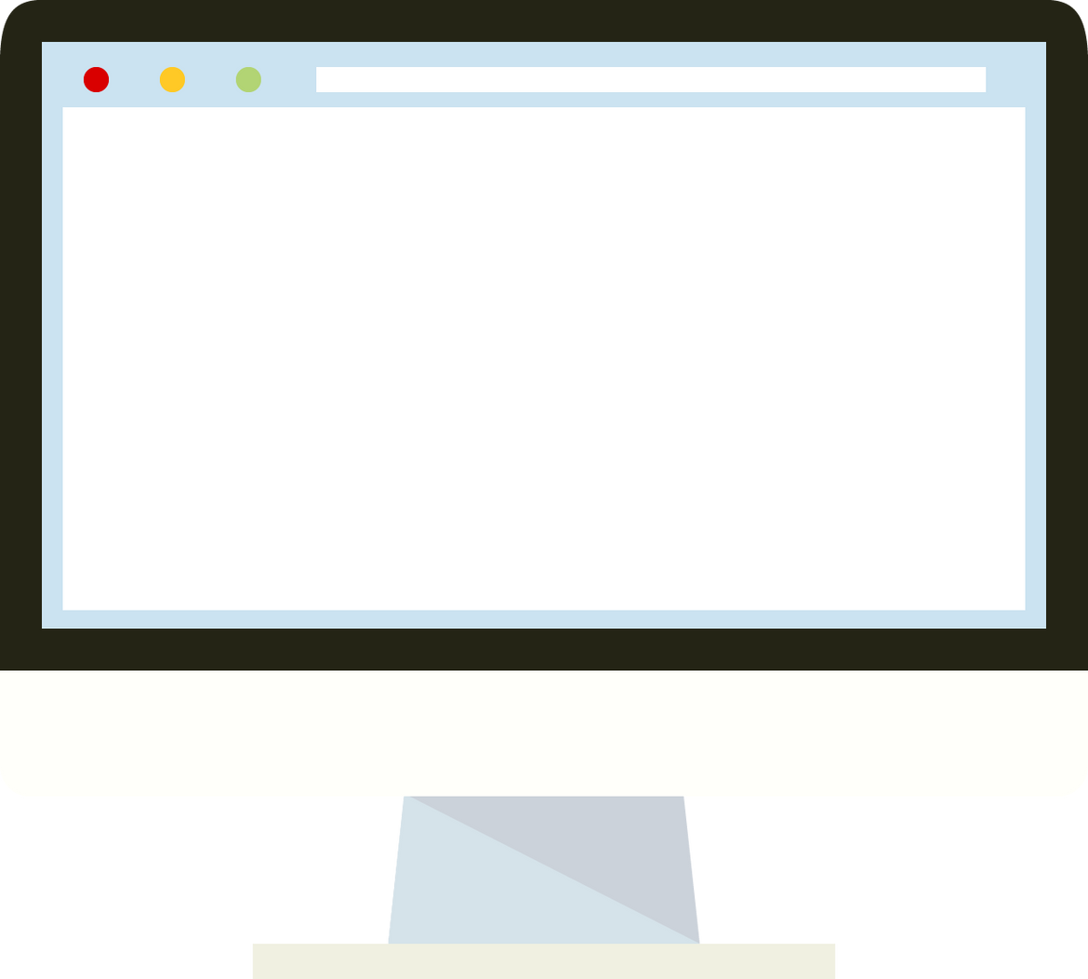

YEAR
2022-23
Python mini project
MENTOR : Krishna Patel
BY:-
SAHIL SHUKLA
20DCS123

Slide 2

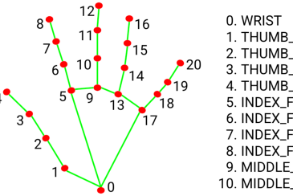
PROJECT TITLE
GESTURE VOLUME AND BRIGHTNESS CONTROLLER
Project Domain/Area
DEEP Learning

Slide 3

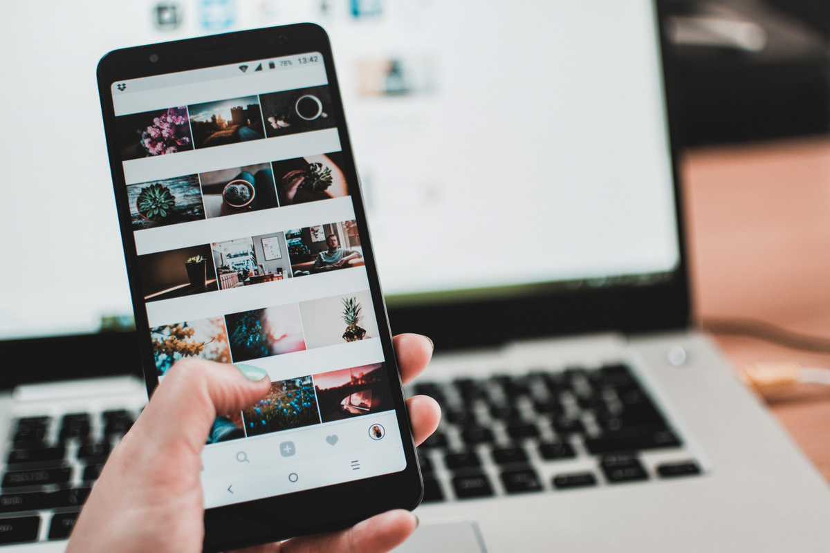

PROPOSED SYSTEM
Project
The proposed system is a gesture based volume and brightness control system for computer.With the help of deep learning and opencv the hand landmarks will be detected and then the fingers will me maped and through the help of the movement and distance between the thumb and index finger tip the volume and brightness level will be controlled. This system will allow the user to control the volume and brightness without actually using any button and manual approach.
SCOPE OF SYSTEM
The gesture recognition market is expected to register a CAGR of over 27.9% over the forecast period (2021 - 2026).(from mordor intelligence). As per the data there is large scope and demand for gesture related software.

Slide 4


TECHNICAL STACKS
PYTHON
ANACONDA
OPENCV
Python is an interpreted high-level general-purpose programming language.
Anaconda is a distribution of the Python and R programming languages for scientific computing that aims to simplify package management and deployment.
OpenCV provides a real-time optimized Computer Vision library, tools, and hardware.OpenCV is a great tool for image processing and performing computer vision tasks.

Slide 5
01.
03.
cv2
NumPy
cv2 is the module import name for opencv-python
NumPy is a general-purpose array-processing package.
02.
04.
Mediapipe
pycaw
Mediapipe is a cross-platform library developed by Google that provides amazing ready-to-use ML solutions for computer vision tasks.
Python Core Audio Windows Library
Libraries

Slide 6
Approch Of Accomplishment
03.
Map the distance of thumb tip and index finger tip
01.
Detect Hand landmarks
02.
04.
Calculate the distance between thumb tip and index finger tip.
Integrate the program with computer audio

Slide 7
Project Plan
03.
01.
mapping
05.
LEARNIG
mapping of the distance between fingers.
Integration
Learning basics of python and opencv
Integrating the computer audio
02.
04.
06.
Detection
Responsive
Revisions
Hand gesture detection
Making it responsive and easy to use.
Test usability and run. Collect feedback and iterate.

Slide 8
Project Timeline
JAN
FEB
MARCH
APRIL
IDENTIFICATION OF PROJECT DEFINATION
Design
BASIC LAYOUT
Adding hand gesture recognition
Development
finger mapping and integration with computer audio
FINISHING
Final touchup and end time modifications(if required).

Slide 9
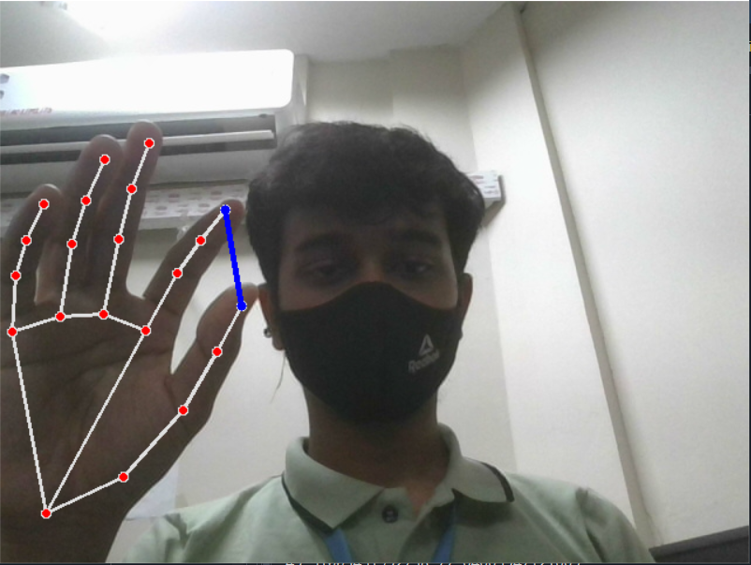
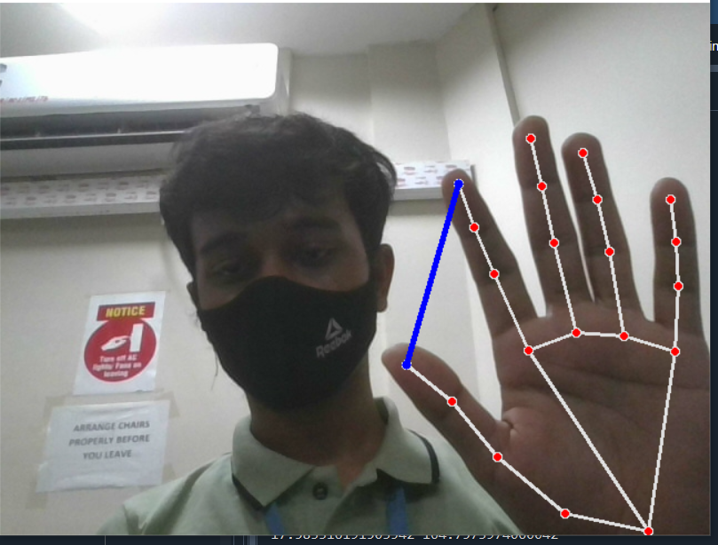
Project Implementation
VOLUME OR BRIGHTNESSDECREASE
VOLUME OR BRIGHTNESS INCREASE

Slide 10
Limitations
03.
01.
UI
Gestures
For now, there is no focus on UI its will be just an basic application
Only hand gestures are detected for now
02.
Fetures
For now, there will be an only volume and brightness control

Slide 11
Future Scope
01.
03.
04.
More Gestures
Ui
Subscription
To add more gestures track elements.
To make an interactive and user friendly UI for application.
To add a Subscription model.
02.
04.
05.
Features
Security
Scale Up
To add more features than volume control
To built more secure system.
To scale up the product to larger extent.

Slide 12

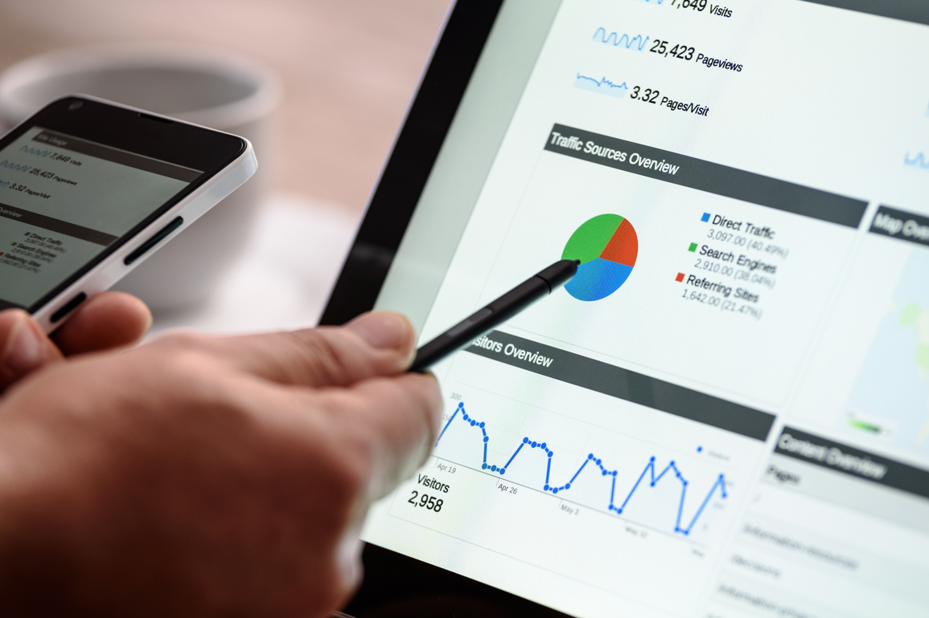
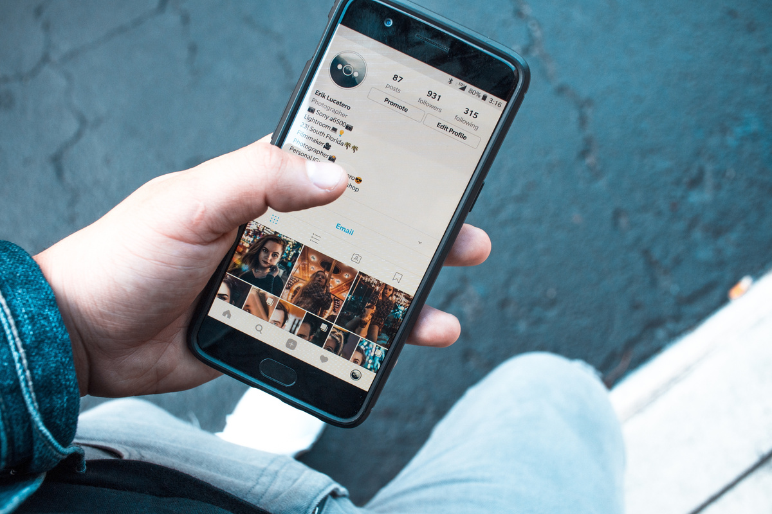
Refrences
01
https://www.pyimagesearch.com/2018/07/19/opencv-tutorial-a-guide-to-learn-opencv/
02
https://www.javatpoint.com/opencv
03
https://www.simplilearn.com/tutorials/php-tutorial/php-login-form
04
https://aihubprojects.com/hand-detection-gesture-recognition-opencv-python/

Slide 13


